Slide 1
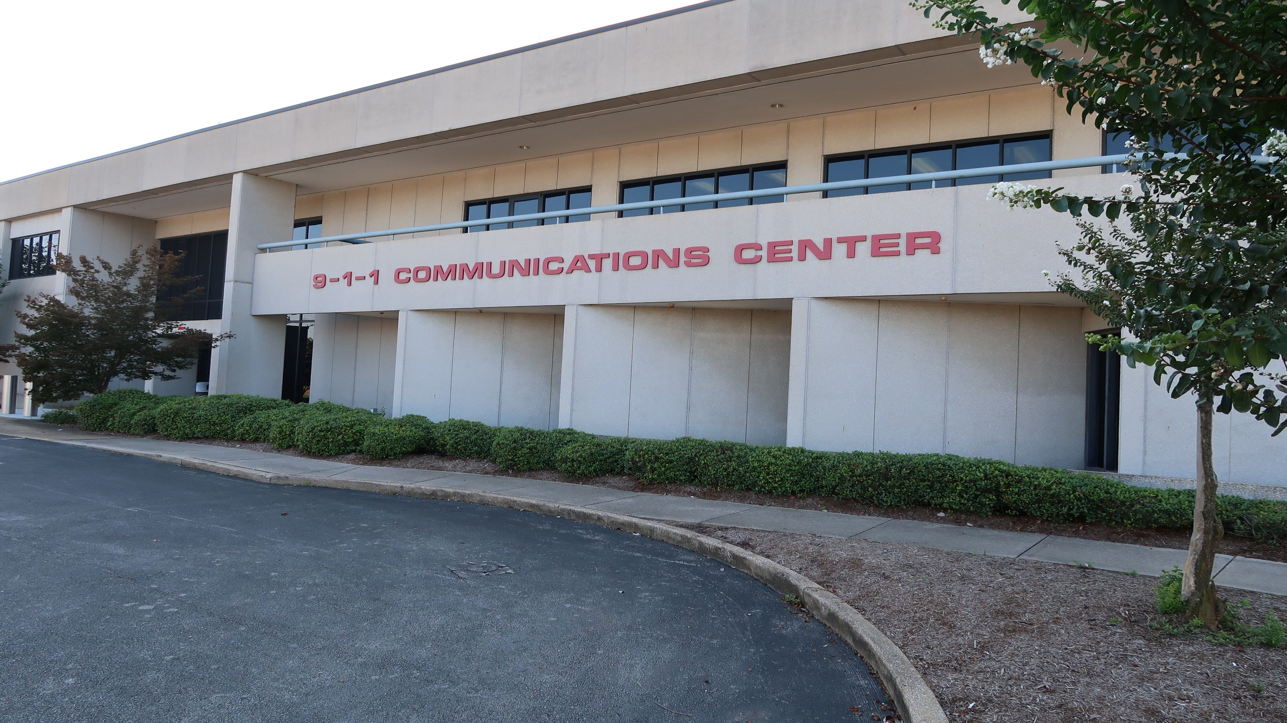
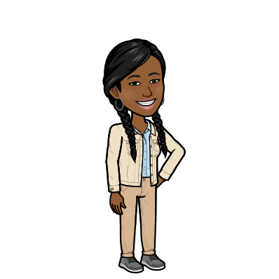


Hamilton County
9-1-1
Emergency Communications District’s
Public Education Classroom
Kids
Teens
Adults
Hi,
my name is Tiana!
Welcome to Hamilton County
9-1-1.
How to Explore
Click on your age group.
Click on different images to learn information and play games!

Slide 2

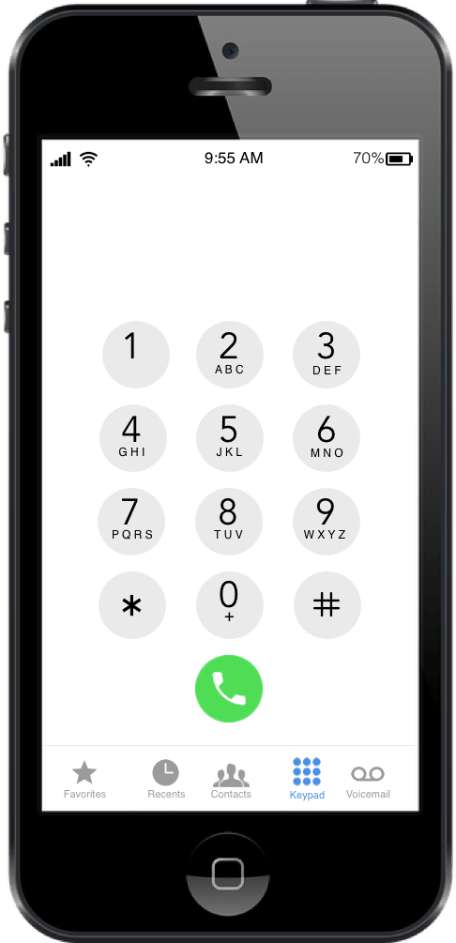
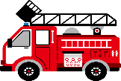


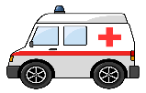
Contact 9-1-1 to:
Only use 9-1-1 for real emergencies!
Report a Fire
Stop a Crime
Practice calling 9-1-1 HERE!
Save a Life
Dial the numbers:
9 1 1
If the phone is locked and you need to call 9-1-1, push the button that says
EMERGENCY
on the lock screen!
Now practice calling the family member you would talk to after calling 9-1-1!

Slide 3




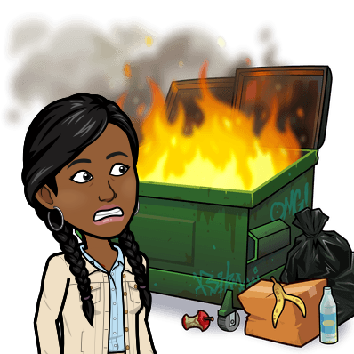

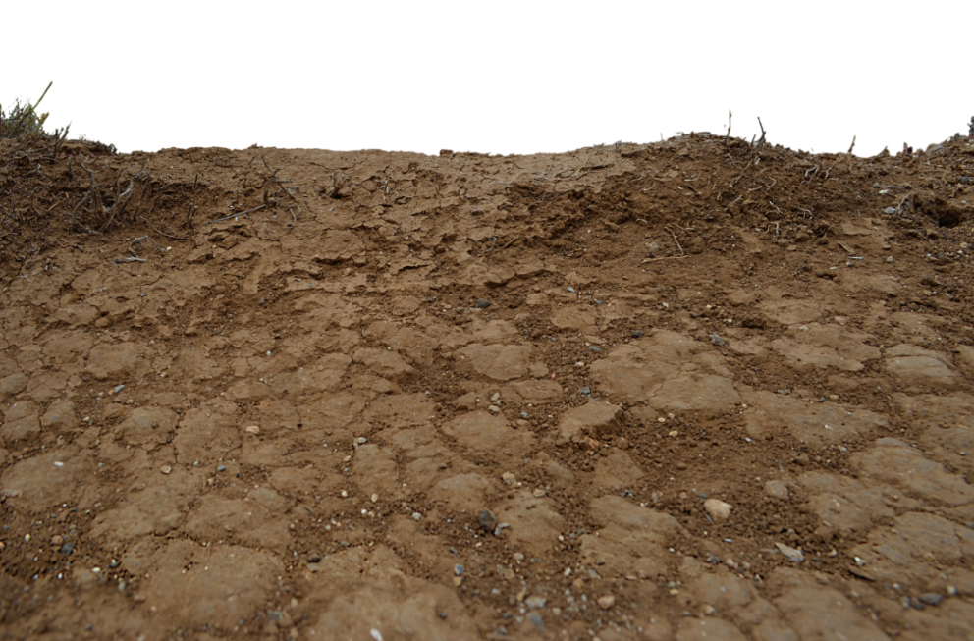


Call 9-1-1 to report a fire!
Call 9-1-1 to report a crime!
Call 9-1-1 to save a life!

Slide 4


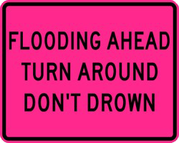
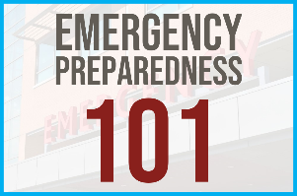
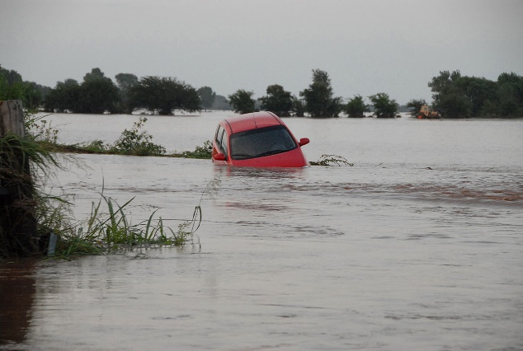



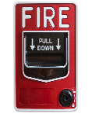
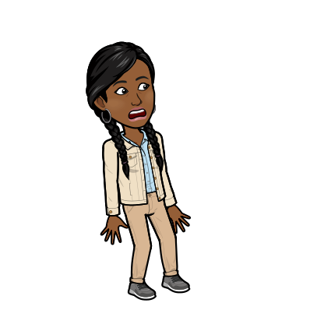

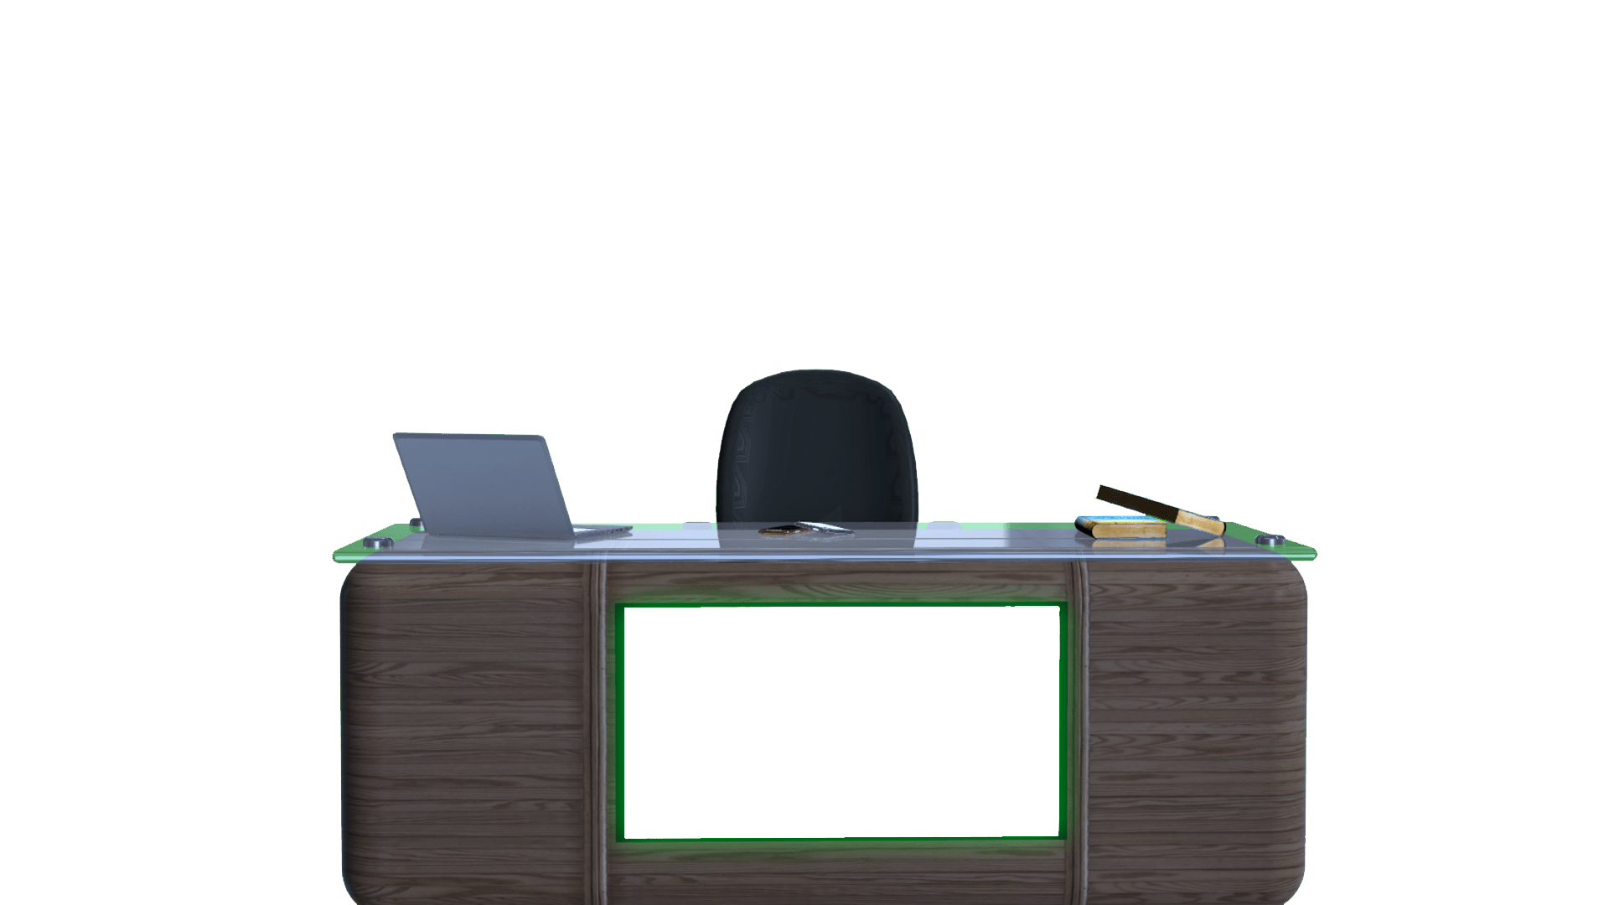





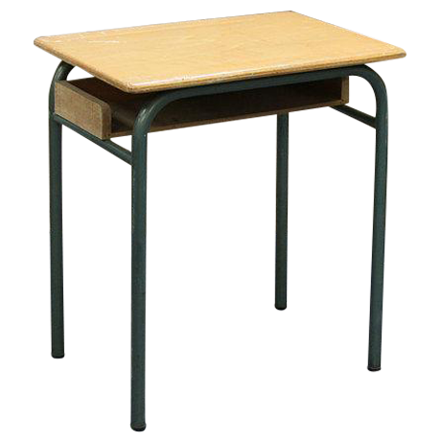
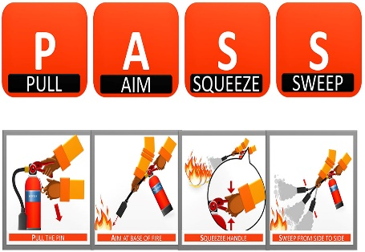










EARTHQUAKE SAFETY TIPS
When SHAKING STOPS, see if you’re hurt!
If outside during an earthquake, STAY OUTSIDE!
If in a car, STAY THERE with SEAT BELT ON!
FIRE SAFETY TIPS
Matches and lighters are NOT toys!
See a fire? Yell ‘FIRE!’ and get to safety!
If on fire, STOP, DROP, and ROLL!
FLOOD SAFETY TIPS
DON’T PLAY in flood water!
If in a car, GET OUT and go to HIGHER GROUND!
DON’T EAT food that has contacted flood water!

Slide 5






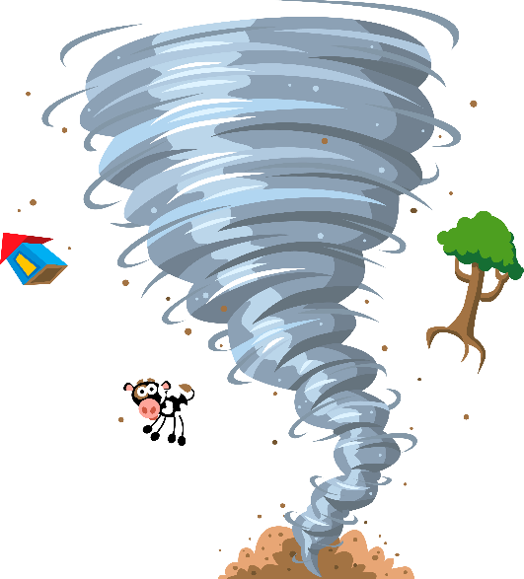

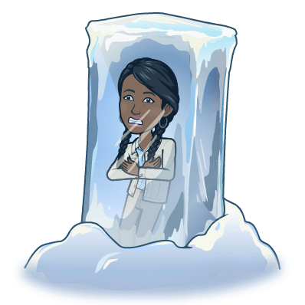
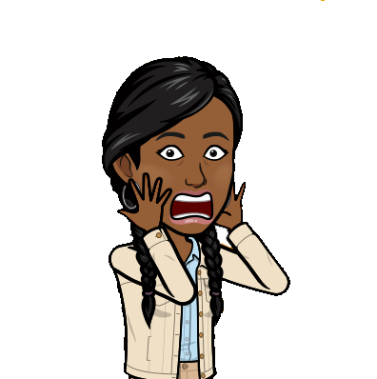







Winter STORMs
TORNADOES
THUNDERSTORMS
Can be SEVERAL INCHES of snow over a FEW HOURS
Can be BLIZZARD CONDITIONS that lasts SEVERAL DAYS
Best way to STAY SAFE is to STAY INSIDE
Dress in MANY LAYERS to stay warm
Go inside often for “WARM-UP” BREAKS
If you get REALLY COLD, TIRED OR NUMB, go inside and tell someone
Are nature’s MOST VIOLENT STORMS
Looks like a FUNNEL CLOUD and sounds like A TRAIN OR PLANE
Can DESTROY an area in SECONDS
If you see/hear a tornado, TAKE COVER IMMEDIATELY
Get under something STURDY
If outside, GO INSIDE immediately TO A BASEMENT
Bring SEVERE WEATHER, like heavy rain, strong winds, and tornadoes
LIGHTNING always comes with a thunderstorm
If you see/hear a thunderstorm coming, GO INSIDE a building or car
If you are swimming, GET TO LAND immediately
Lightning can make ELECTRONICS DANGEROUS

Slide 6





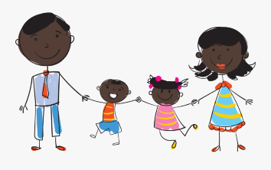



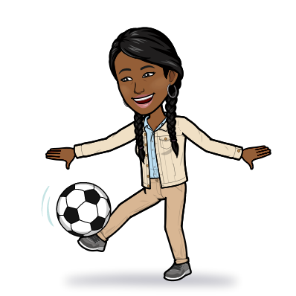

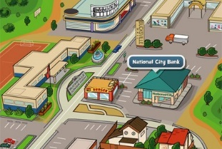



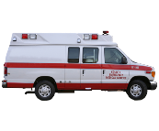

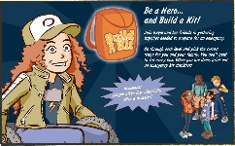











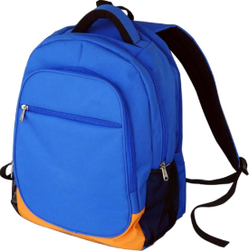






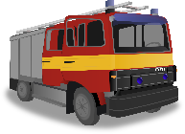


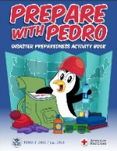


Know about disasters to be prepared!
Click on the disaster images to learn more!
Do you know the names of your family members?
National Preparedness Month
1. Make a plan
2. Build a kit
3. Be ready
Disasters
How will you talk to your family during an emergency or disaster?
Click on the phone to make a family communication plan!
Do you know where you live?
Build a kit so you are ready for disasters and emergencies!
Click on the backpack for a list of emergency supplies!
Play the Disaster Master game!
Play the Build a Kit game!
Call 911 for emergencies!
Read the Prepare with Pedro Disaster Preparedness Activity Book!
911

Slide 7




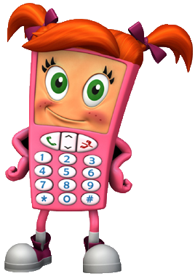
Hey, meet my friends Red E. Fox and Cell Phone Sally!
Visit the 911 for Kids website!
Meet Cell Phone Sally! She knows all about 911! Click on her to learn more!
Meet Red E. Fox! He is super smart about 911! Click on him to learn more!

Slide 8




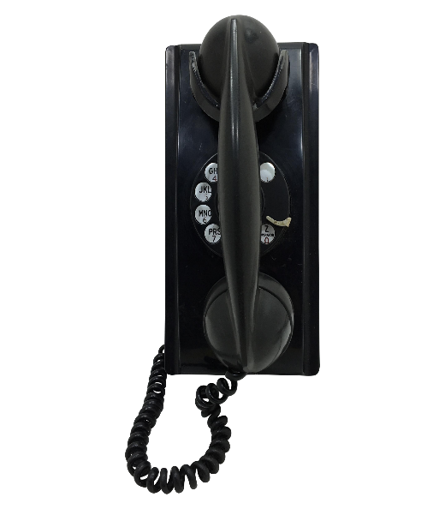









The 4 Ws:
When you call into 911, expect to be asked MANY questions! All these questions are IMPORTANT in helping with your emergency.
Please have PATIENCE when being asked these questions.
These questions will be asked when you call 911!
WHERE is helped needed?
WHAT is happening?
WHEN did the event occur?
WHO needs help?
Questions??
If you call by mistake, DO NOT HANG UP the phone! Tell the call taker that there is no emergency.
WHERE is the most important info to give to 911!
Learn some info about calling into 911!
Try to stay calm when calling 911!
The person who will answer your 911 call is a TELECOMMUNICATOR!
Telecommunicators have a list of instructions that can help you with different emergencies, from giving someone CPR to delivering a baby.

Slide 9













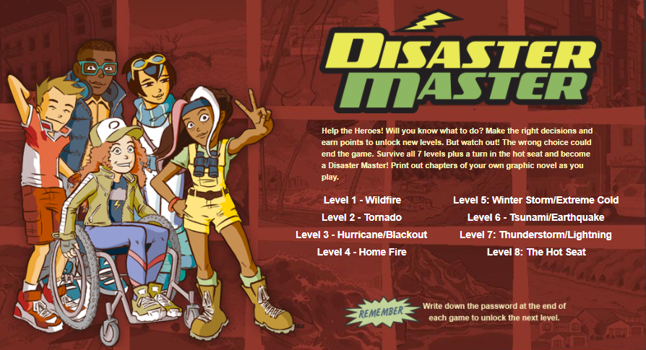


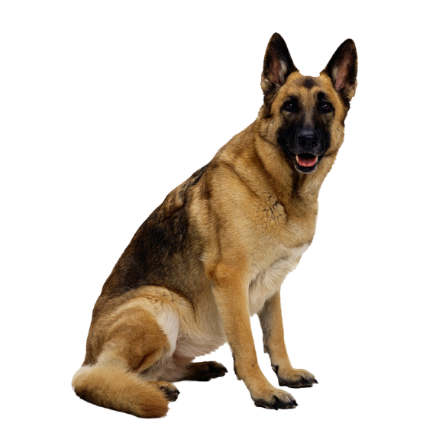




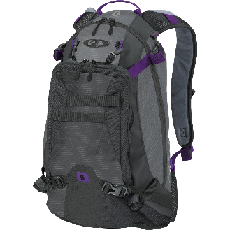





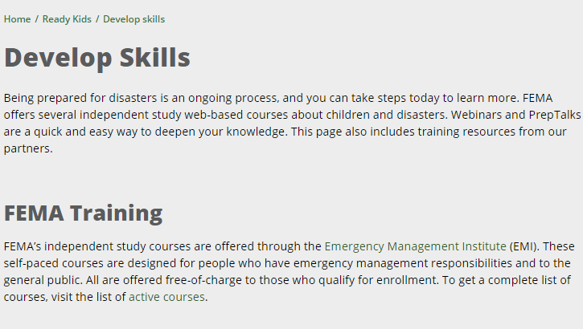



Encourage your friends to be ready for emergencies!
It is important to stayed informed on disaster and emergency preparation.
Click on the books to explore the Resource Library!
Joining or starting a club about disaster prep can help your community.
Click on the whiteboard to learn how to get involved!
Club Meeting at 4!
Follow us on Facebook!
Do you have an emergency supply kit?
Do you want to develop skills to help in disaster and emergency preparedness?
Click on the laptop to get started!

Slide 10


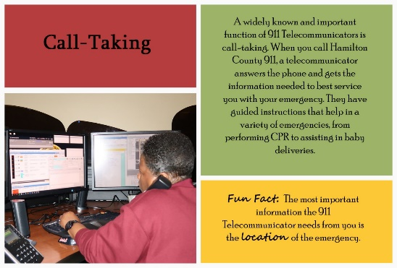
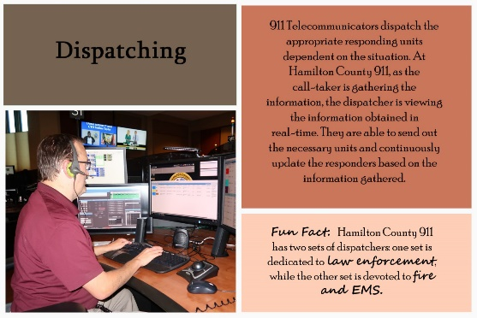


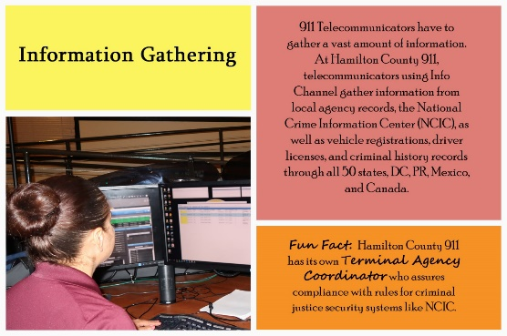
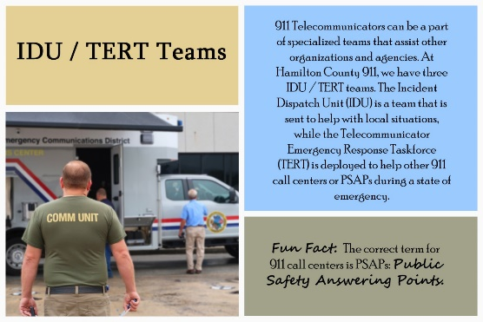

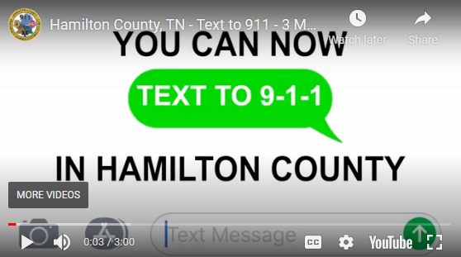





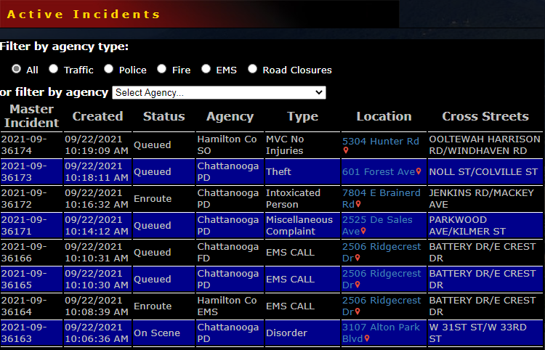




Dispatching
PulsePoint Respond can inform you of nearby emergencies and request your help when CPR is needed.
Click on the banner to download the app!
Call-Taking
Learn some info about Hamilton County 911!
Our staff is trained in a variety of disciplines!
Info Channel
IDU / TERT
Teams
Watch the Text to 9-1-1 video!
View the Active Incidents Page!
(423)
698-
2525
Need to contact someone but not sure who to call?
Click on the phone for non-emergency numbers!
Interested in a career with Hamilton County 911?
Click on flyer to see if we are hiring and/or to fill out a job interest form!

Slide 11




FIRE
Choose an outside meeting place
Have escape routes and practice them
Explain that they should feel a door before opening it
CRIME
ACCIDENTS
Practice “stop, drop and roll”
Teach them to call 9-1-1 to report a crime
Teach children how and when to call for help!
Tell children about the people that can help in an emergency!
Help children recognize warning signs for disasters in the area!
Teach them to call 9-1-1 if someone is unconscious
Teach them prank calling 9-1-1 can be a crime
Teach them to call 9-1-1 if someone is having difficulty breathing
Teach them how to stay safe
Teach them to call 9-1-1 if there has been a serious car accident
FLOODS
It is important to prepare your youth for emergencies!
Be alert during a flood/flash flood watch
Take action during a flood/flash flood warning
Discuss flooding to reduce fear
Know if you are in a floodplain

Slide 12












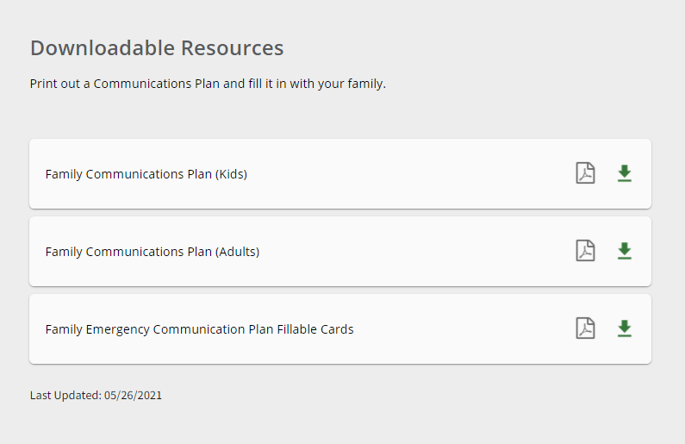






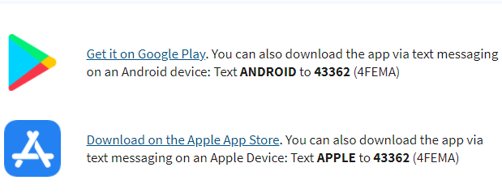


Will you be ready in time?
It is important to know how to help children cope with emergencies and disasters.
Click on the family picture to learn coping techniques!
Make an emergency supplies checklist!
Download the FEMA Mobile App!
Ensure that you know how to contact your family during an emergency or disaster.
Click on the laptop to make a family communication plan!
Are you financially prepared for an emergency or disaster?
Click on the TV to watch a video about financial preparedness!
Do you have a plan in place?
Teach kids how to use 911!

Slide 13






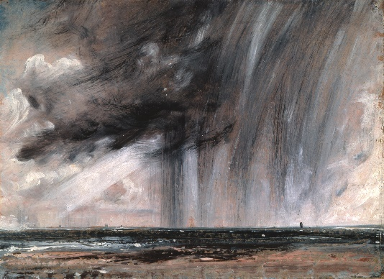
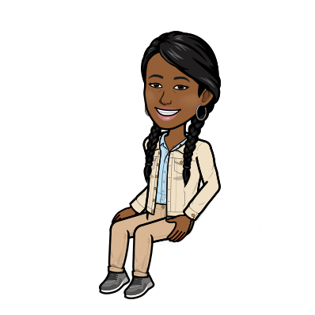

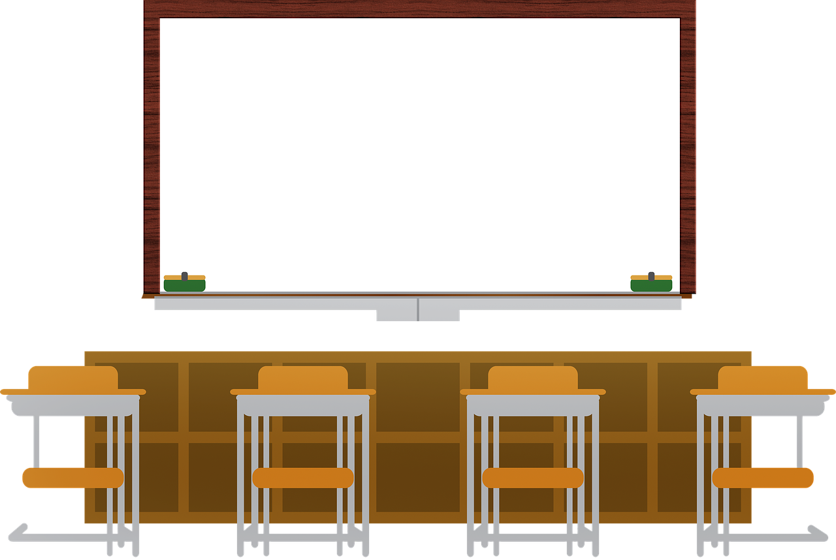


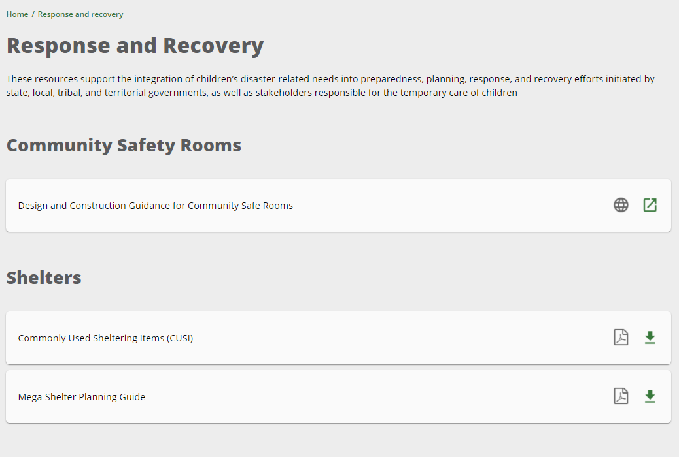






Teach your youth to be ready for disasters.
Click on the painting for disaster facts!
View the 911 Lesson Plan!
Youth Emergency Preparedness
Curriculum
Explore the Resource Library!
1. Leadership 4. Creativity
2. Teamwork 5. Communication
3. Problem Solving
Are you prepared to help your students?
Do you know how to address the needs of children during disasters?
Click on the computer for response and recovery resources!
It is important to teach youth about emergency and disaster preparedness?
Click on the whiteboard for educational resources!

